Slide 1



Computer Networks
Module 1
Introduction to Networking

Slide 2
Outline
Communication System
Basic Concepts
Line Configuration
Transmission mode
Types of Networks
Network Topology

Slide 3

What is Networking?
In simple term “ A network is simply a collection of computers or other hardware devices that are connected together, either physically or logically using special hardware and software in order to exchange information.”
And Networking is term that describes the process involved in design, implementation, management of network using network technology.

Slide 4
Introduction to Communication System
Data Communication is a process of exchanging data or information and in case of computer networks it done in between two or more devices over a transmission medium.
Communication system consists of Hardware and Software.
Hardware: Sender, Receiver and Intermediate devices
Software: Set of rules and protocols that need to satisfied.

Slide 5
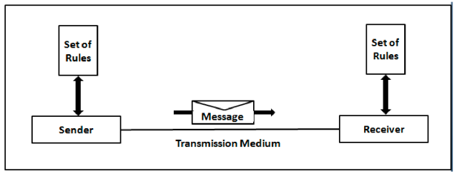

Components of Data Communication
Components:
Message
Sender
Receiver
Transmission Medium
Protocols

Slide 6

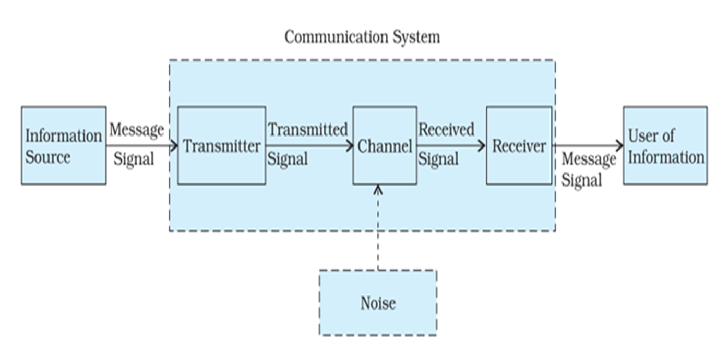
Elements Of Communication System

Slide 7
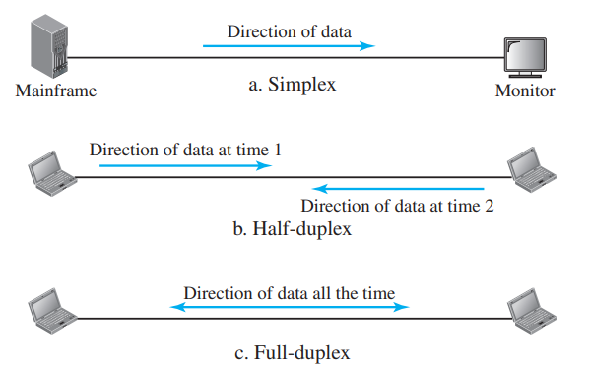
Data Flow
Simplex
Half-Duplex
Full Duplex

Slide 8
Network Criteria
Performance:
Can be measured in terms of
Transit time
Response time
Evaluated by two networking metrics: Throughput & Delay
Reliability: measured by frequency of failure, time taken by link to recover from failure and network robustness ion catastrophe
Security: Securing data from unauthorized access, protecting data from damage, implementing policies, recovery from breaches and data loss.

Slide 9

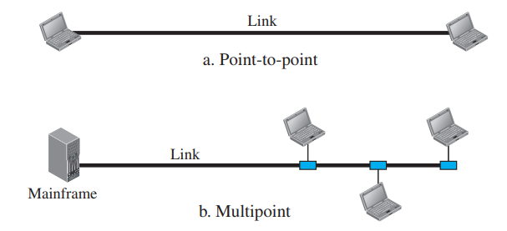
Physical Structures
Type of Connections:
Point-to-Point connection:
Provides dedicated link between two devices
Entire link capacity is reserved between two devices
Multipoint (Multidrop):
More than two devices share a single link.
Capacity of channel is shared
Channel is shared either Spatially or Timeshared.

Slide 10
Physical Topology
Physical Topology refers to a way in which network is laid out physically.
Topology is geometric representation of relationship of all the links and linking devices (also called nodes) to one another.
There are Four basic Topologies:
Mesh
Star
Bus
Ring

Slide 11
Mesh Topology
Every device has a dedicated point-to-point link to every other device.
Link carries traffic only between the two devices it connects.
Total number of physical links in a fully connected mesh network with n nodes is equal to n(n-1).
In case of communication in both direction : n(n-1)/2 duplex node links.
Every device on network must have (n-1) input/output (I/O) ports.

Slide 12
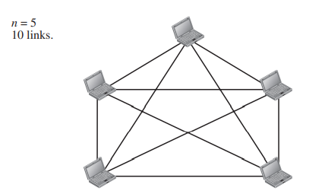
Mesh Topology
Advantages
No traffic problems
Robust
Privacy and security
Point to point link: fault identification and isolation is easy
Disadvantages
Installation and reconnection difficult as devices interconnected.
Bulk wiring
Expensive: hardware cost

Slide 13
Star Topology
each device has a dedicated point-to-point link only to a central controller, usually called a hub.
devices are not directly linked to one another.
star topology does not allow direct traffic between devices.
The controller acts as an exchange, it relays the data to the other connected device.
The star topology is used in local-area networks (LANs)

Slide 14
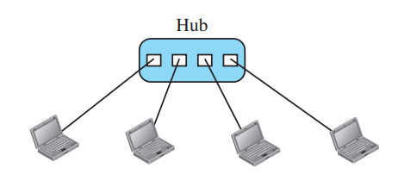
Star Topology
Advantages
Less expensive than mesh
Reconfiguration and installation is easy.
Robustness
Easy fault identification as long as hub is working
Disadvantages
Dependency on single point controller.
Each node must be linked to hub: more cabling required compared to other topologies except mesh.

Slide 15
Bus Topology
A bus topology is multipoint connection.
One long cable acts as a backbone to link all the devices in a network.
Nodes are connected to the bus cable by drop lines and taps.
A drop line is a connection running between the device and the main cable.
A tap is a connector that either splices into the main cable or punctures the sheathing of a cable to create a contact with the metallic core.

Slide 16
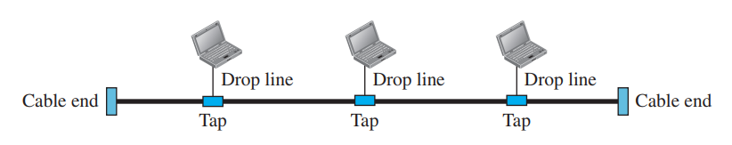
Bus Topology
Advantages
Ease of installation: less cabling as compared to mesh and star.
A bus uses less cabling than mesh or star topologies
Disadvantages
It is Difficult to add new devices.
Difficult reconfiguration and fault isolation.
A fault in Backbone stops all transmission
Limited cable length and number of nodes that can be connected.

Slide 17
Ring Topology
Each device has a dedicated point-to-point connection with only the two devices on either side of it.
A signal is passed along the ring in one direction, from device to device, until it reaches its destination.
Each device in the ring incorporates a repeater.

Slide 18
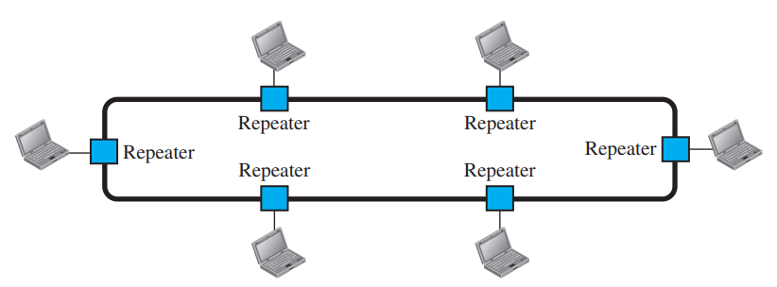
Ring Topology
Advantages
Easy to install and reconfigure.
Easy adding and deleting of connections.
Fault isolation simplified: devices can raise the alarm.
Disadvantages
Unidirectional traffic can be a disadvantage.
Breakdown in ring disables the entire network.

Slide 19
Types of Networks
Local Area Network (LAN)
Metropolitan Area Network(MAN)
Wide Area Network(WAN)

Slide 20
Local Area Networks
A local-area network (LAN) is a computer network that spans a relatively small area.
A local area network (LAN) is usually privately owned and links the devices in a single office, building, or campus.
LAN size is limited to a few kilometers.

Slide 21
Local Area Networks
LANs are designed to allow resources to be shared between personal computers or workstations.
Example: hardware or software
One of the computers may be given a large capacity disk drive and may become a server to clients.
LAN extends up to 10m to 1km

Slide 22
Local Area Networks
LANs are distinguished from other types of networks by their transmission media and topology.
Speeds: 100 or 1000 Mbps.

Slide 23
Metropolitan Area Networks
Metropolitan Area Network usually covers area inside a town or a city.
It is designed for customers who need a high-speed connectivity, normally to the Internet, and have endpoints spread over a city or part of city.
Example: cable TV network
MAN extends up to 30-40 km.
Speed of 34–155 Mbit/s.
MAN uses Guided Media or Unguided media.

Slide 24
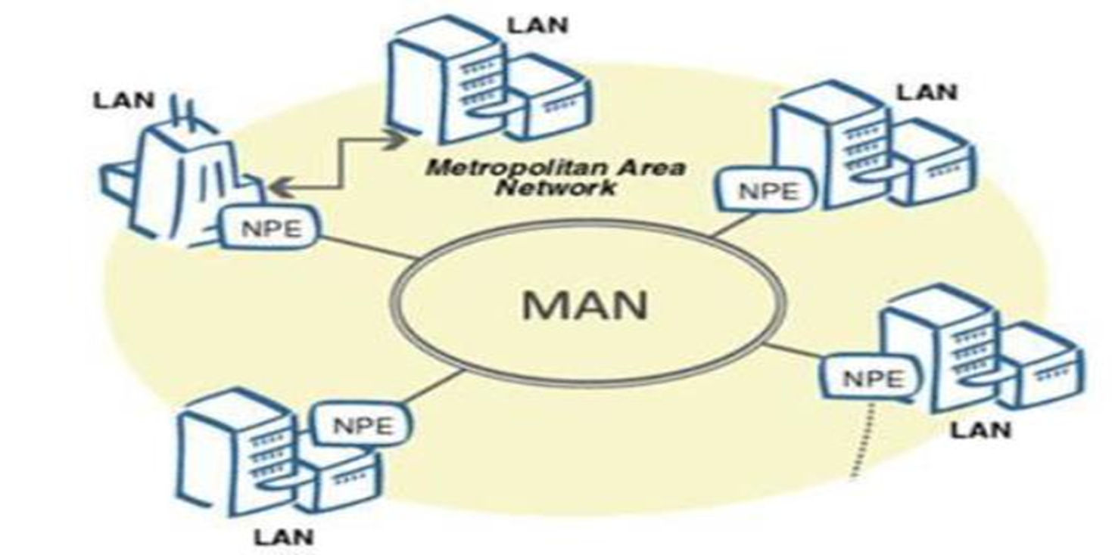
Metropolitan Area Networks

Slide 25
Wide Area Networks
A wide area network (WAN) provides long-distance transmission of data, image, audio, and video information over large geographic areas that may comprise a country, a continent or even the whole world.
WAN (Wide Area Network) is a group of computers and other network devices which are connected and not restricted to a geographical location.
Internet is WAN.

Slide 26
Wide Area Networks
WAN speed varies based on geographical location of the servers. WAN connects several LANs.
WAN connection speeds can be 10Mbps or 100Mbps.
WAN mainly uses Guided Media or Unguided media.

Slide 27
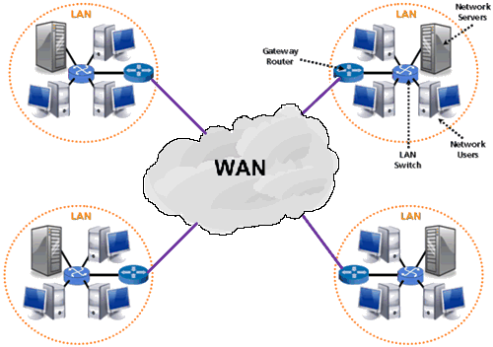
Wide Area Networks

Slide 28
Switching
An internet is a switched network in which a switch connects at least two links together
The two most common types of switched networks are circuit-switched and packet-switched networks.
Circuit-Switched Network
Packet Switched network

Slide 29
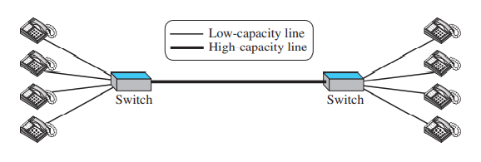
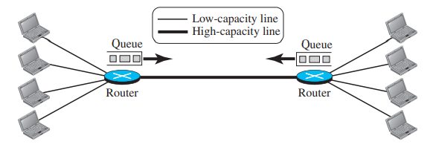
Switching
A Circuit Switched network
A Packet Switched network

Slide 30
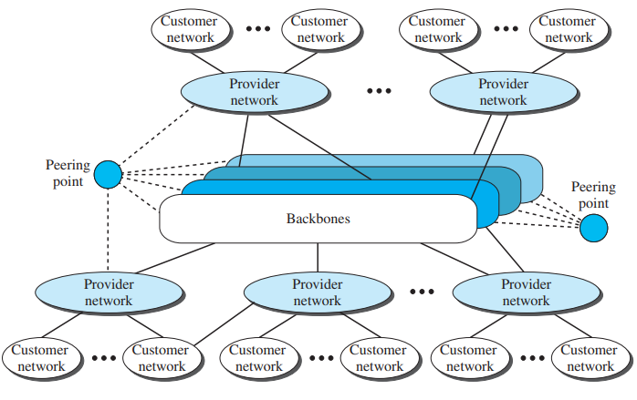
The Internet Today

Slide 31
Network Models
Protocol Layering:
ISO OSI Model
TCP/IP model

Slide 32
Design Issues for Layers
Addressing - whom am I going to talk to? i.e., how do we identify senders and receivers?
Rules for data transfer: Simplex (one-way channels), half-duplex (two-way communication but not simultaneously) and full duplex (2 way)
Logical channels: usually at least 2. One for normal mode and one for urgent transmission.

Slide 33
Design Issues for Layers
Reconstituting messages: Out of order messages need to be numbered.(Flow Control)
Error control: This is all about communicating along imperfect channels and error correction in such cases. (Issues: Attenuation, delay distortion and noise).
Large messages: Procedures for disassembling, transmitting and reassembling. What to do when messages are very small (compared to packet)?

Slide 34
Design Issues for Layers
Multiplexing: One connection per conversation or many on one connection. Important in physical layer where only a few lines are available
Routing: What to do when there are multiple paths between communicating machines

Slide 35
Connection Less Services
No session connection between sender and receiver.
No reliability
Short messages
Does not maintain state information.
Less overhead
Example: Walkie-Talkie

Slide 36
Connection Oriented Services
Requires session connection (analogous to a phone call).
Reliable network service.
Set up virtual links between the end systems through a network.
Long messages.
High overhead and places greater demands on B/W.
Example: Email

Slide 37
The OSI model
Over the past couple of decades many of the networks that were built used different hardware and software implementations, as a result they were incompatible, and it became difficult for networks using different specifications to communicate with each other.
The Open System Interconnection (OSI) model includes a set of protocols that allows any two systems to communicate regardless of their architecture.

Slide 38
The OSI model
The OSI model is a concept that describes, how data communications should take place.
OSI is also called as the framework for design of network systems.
It divides the process into seven steps called layers.

Slide 39
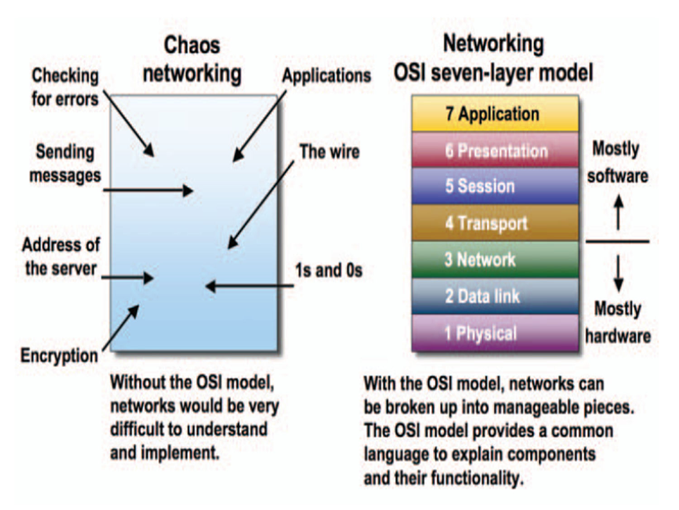
The OSI model

Slide 40
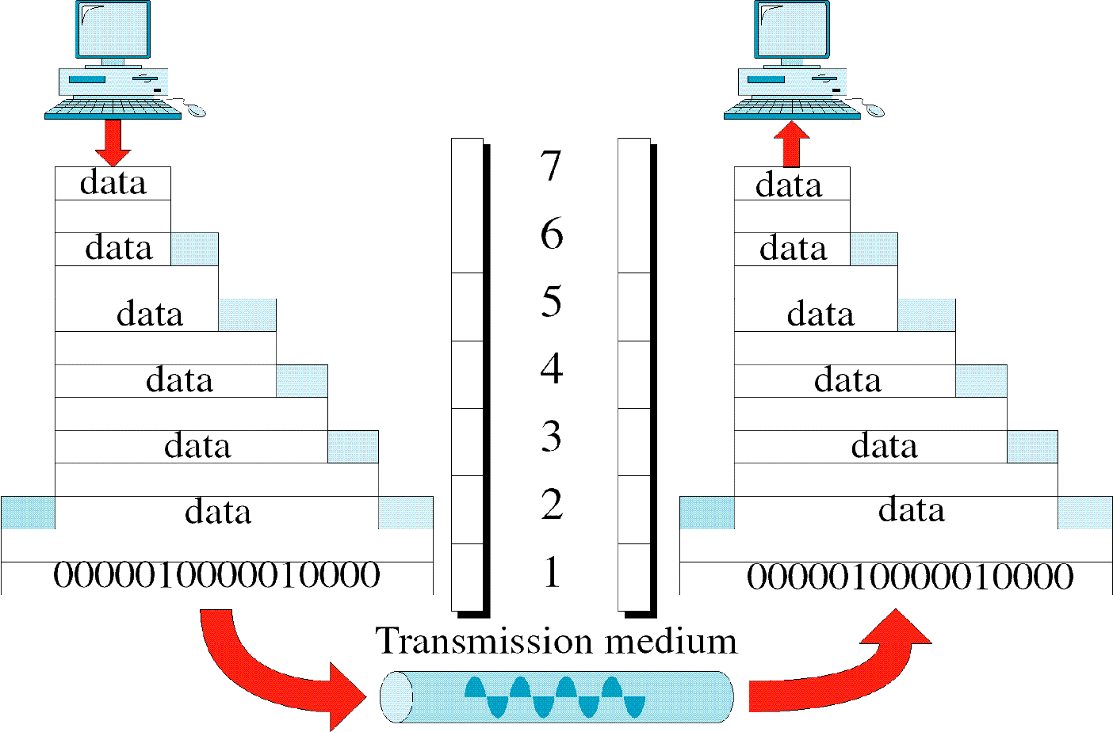
The OSI model
Application Layer
Presentation Layer
Session Layer
Transport Layer

Slide 41
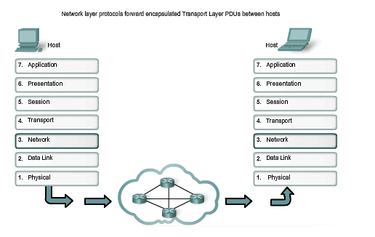
The OSI model

Slide 42
Physical Layer
The physical layer deals with the physical characteristics of the transmission medium.
This layer consists of simply the wire or media by which the network signals are conducted.
The physical layer of the OSI model defines connector and interface specifications, as well as the medium (cable) requirements for transmission to occur.

Slide 43
Physical Layer
Functions of physical layer:
Physical characteristics of interfaces and medium.
Representation of bits: Conversion from binary to electrical or optical.
Data rate.
Synchronization of bits.
Physical topology
Line configuration: point to point or multipoint.

Slide 44
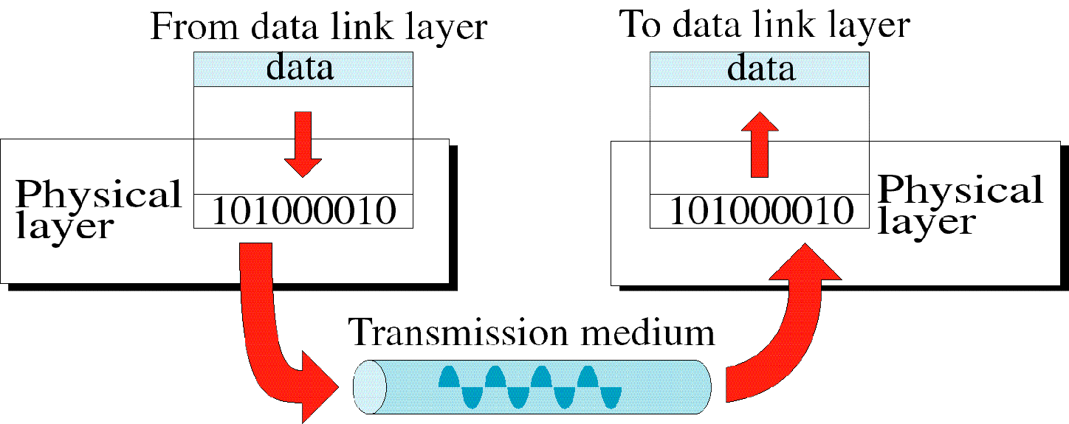
Physical Layer

Slide 45
Data Link Layer
The data link layer transforms the physical layer, a raw transmission facility, to a reliable link.
Node to node delivery
The data link layer uses the MAC address to define a hardware or data link address for multiple stations to share the same medium and still uniquely identify each other.
Concerned with network topology, network access, error notification, ordered delivery of frames, and flow control.

Slide 46
Data Link Layer
Functions of Data Link layer:
Framing
Physical addressing: adding header to frame to identify sender and receiver address.
Flow control
Error control
Access control

Slide 47
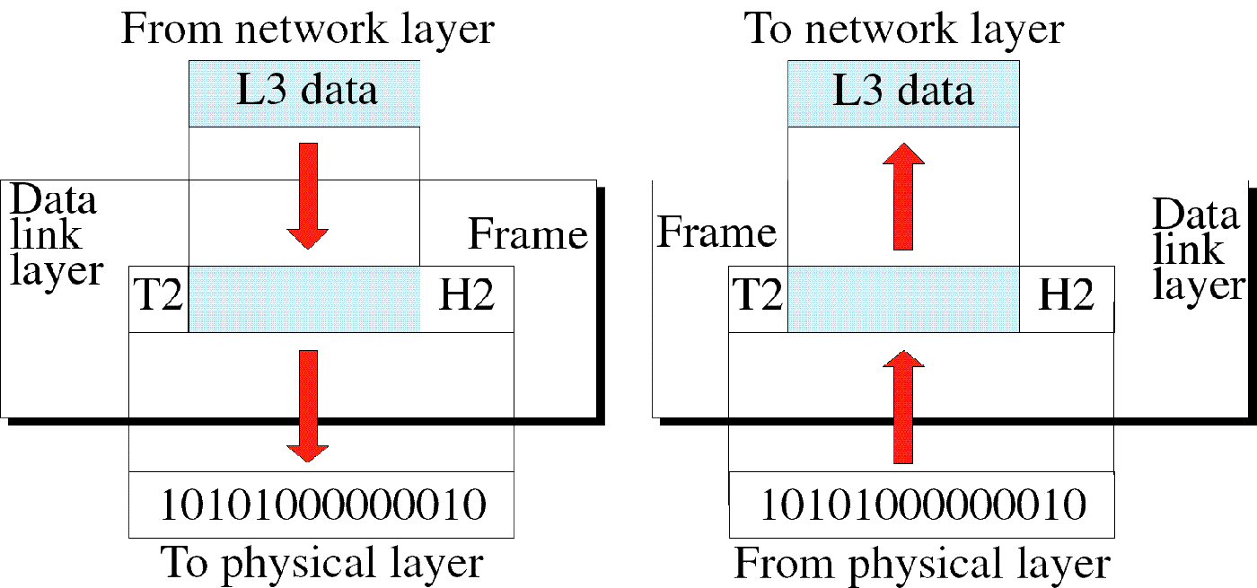
Data Link Layer

Slide 48
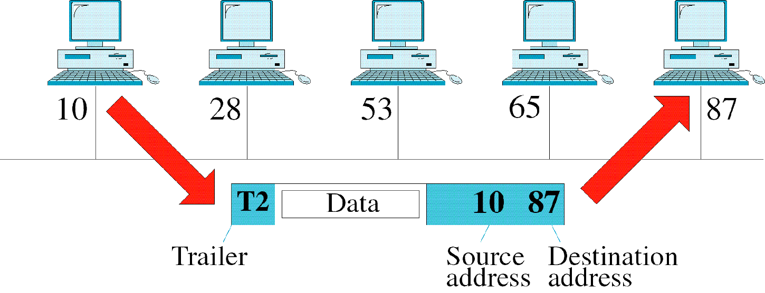
Data Link Layer

Slide 49
Network Layer
This layer establishes the route between the sending and receiving stations.
Responsible for delivery of individual packets from source to destination.
Two systems connected on same link-no network layer.
Two systems on different link - need network layer.

Slide 50
Network Layer
It handles the routing of data (sending in the right direction to the right destination on outgoing transmissions and receiving incoming transmission at the packet). The layer does routing & forwarding of data.
Network layer addresses can also be referred to as logical addresses.

Slide 51
Network Layer
Functions of network layer:
Logical addressing:
Data link layer physical addressing-handles addresses locally.
Packet crosses network boundary-IP addressing.
Routing : Routing packets to destination via connecting devices over large networks.

Slide 52
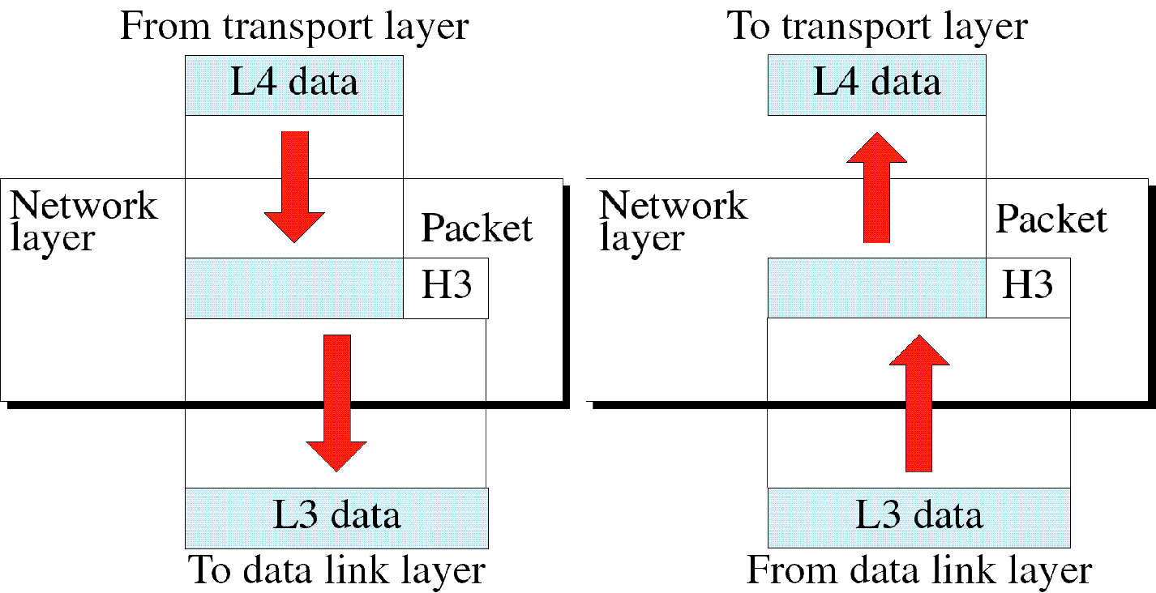
Network Layer

Slide 53
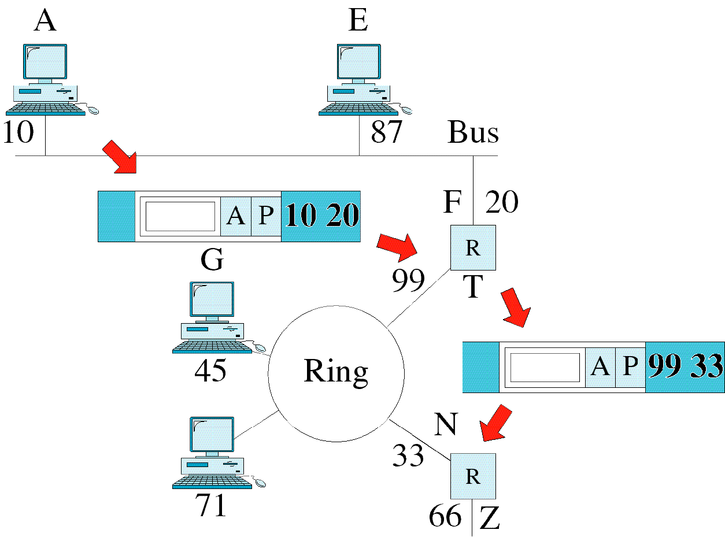
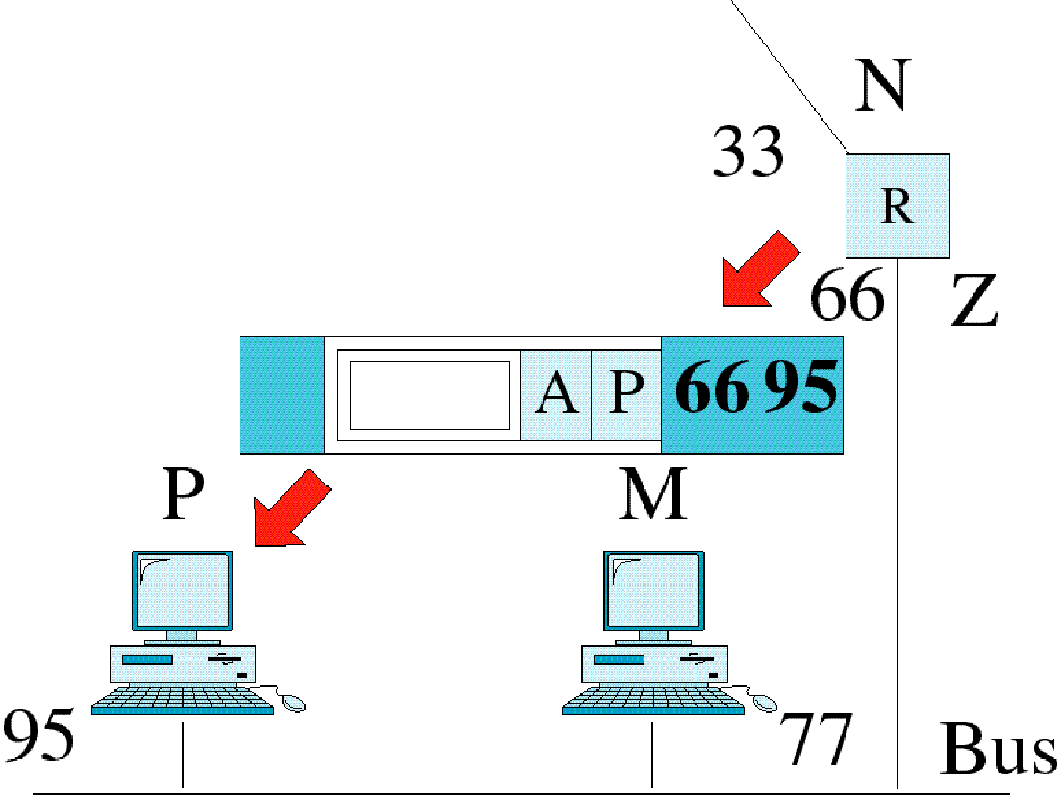
Network Layer Example

Slide 54
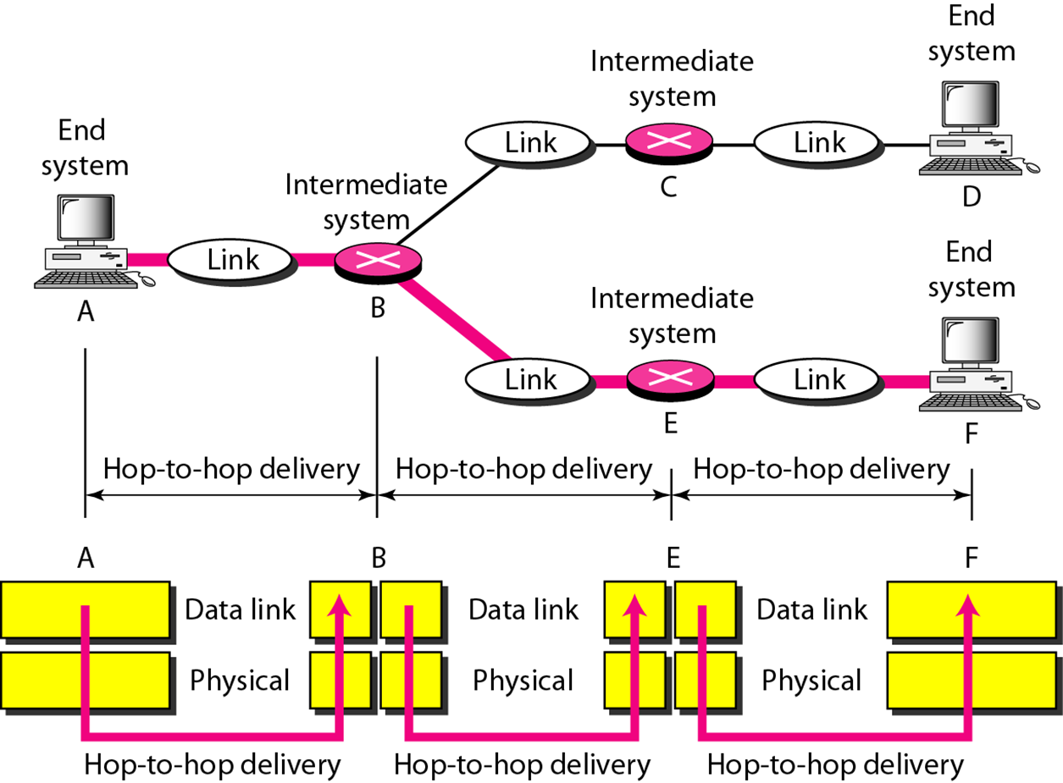
Hop-to-Hop delivery

Slide 55
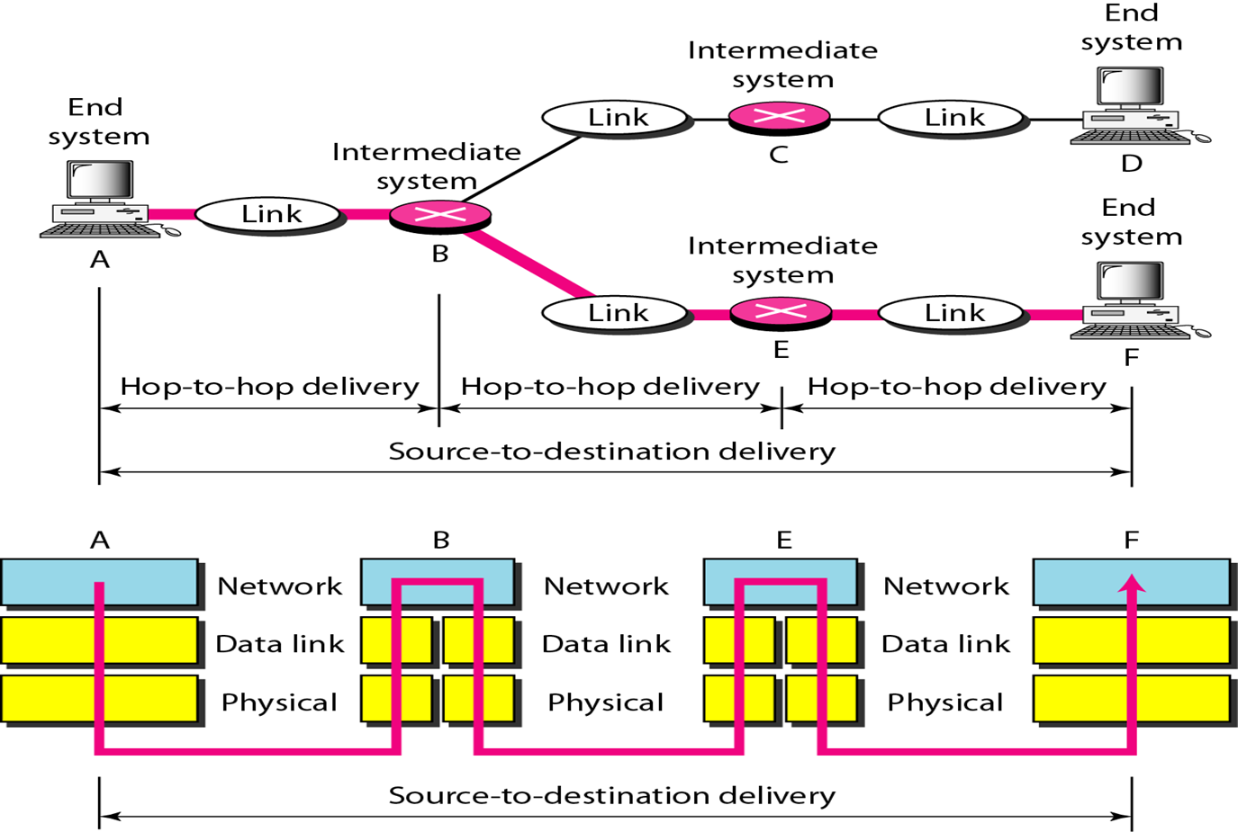
Source-to-destination delivery

Slide 56
Transport Layer
The transport layer is responsible for the delivery of a message from one process to another.
Transport layer recognizes relationship between the packets and makes sure that the whole message arrives intact and in order.
It is responsible for constructing stream of data segments, sending and checking for correct delivery.

Slide 57
Transport Layer
If data is sent incorrectly, this layer has the responsibility to ask for retransmission of the data.
This layer acts as an interface between the bottom and top three layers.

Slide 58
Transport Layer
Responsibilities of transport layer:
Service-point addressing: Port Address(process to process).
Network layer gets each packet to correct computer.
Transport layer gets each packet to correct process on that computer.
Segmentation and reassembly: Message divided into segments-sequence number
Retransmission in case of lost segment.

Slide 59
Transport Layer
Responsibilities of transport layer:
Connection control: Connection-less or connection-oriented.
Flow control : flow control at this layer is performed end to end rather than across a single link.
Error control: error control at this layer is performed process-to-process rather than across a single link.

Slide 60
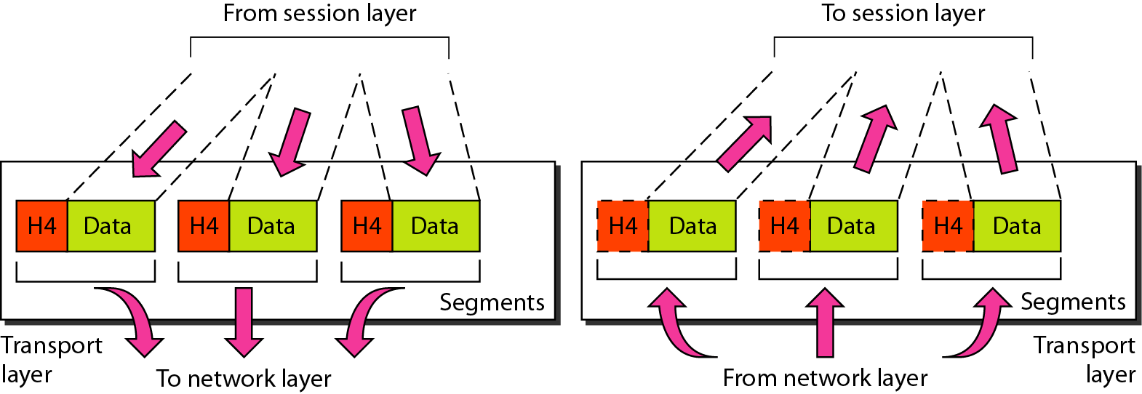
Transport Layer

Slide 61
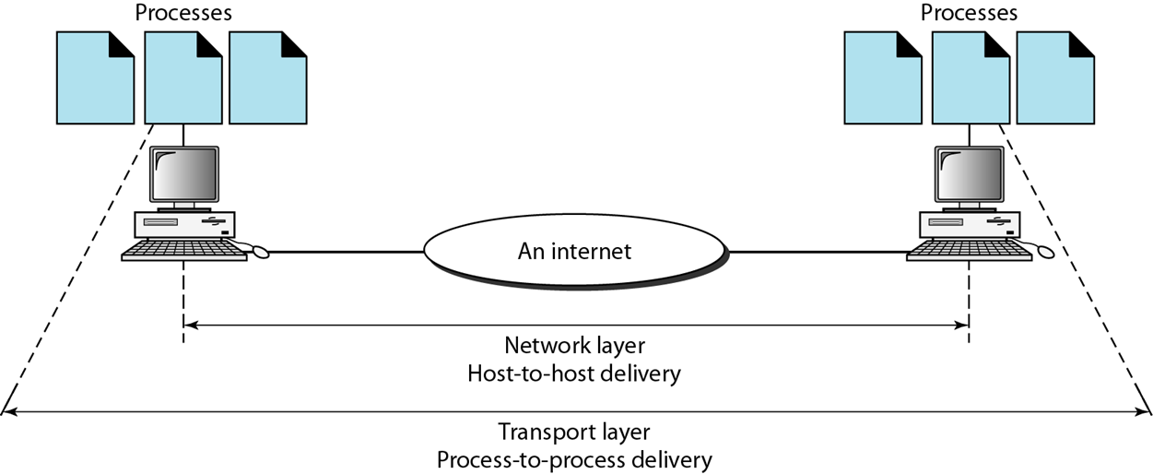

Reliable process-to-process delivery of a message

Slide 62
Session Layer
The services provided by the first three layers (physical, data link, and network) are not sufficient for some processes.
The session layer defines how to start, control and end conversations (called sessions) between applications.
It provides coordination of the communication in an ordering manner.

Slide 63
Session Layer
The session layer offers provisions for efficient data transfer.
Responsibilities of the session layer:
Dialog control : The session layer allows two systems to enter into a dialog.
Synchronization: allows to add checkpoints.

Slide 64
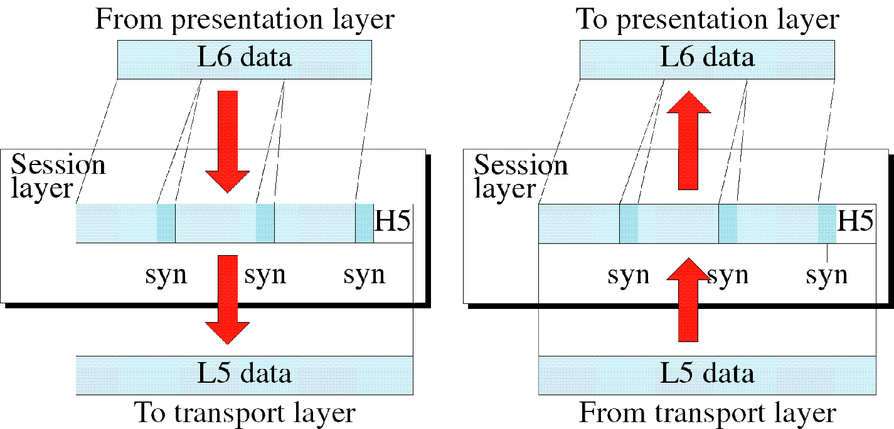
Session Layer
© The McGraw-Hill Companies, Inc., 1998

Slide 65
Presentation Layer
The presentation layer ensures that the information that the application layer of one system sends out is readable by the application layer of another system.
If necessary, the presentation layer translates between multiple data formats by using a common format.
The presentation layer basically allows an application to read (or understand) the message.

Slide 66
Presentation Layer
Responsibilities of presentation layer:
Translation: Changes data so that another computer can read it.
Compression: Makes data smaller to move data in same amount of time.
Encryption: Encodes data to protect from interception.

Slide 67
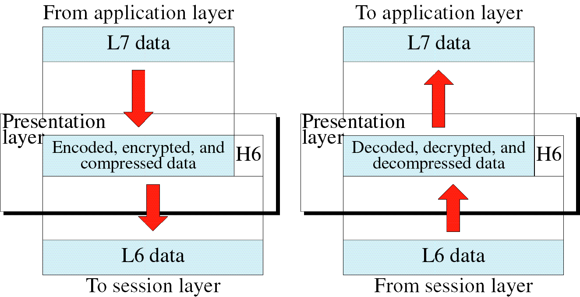
Presentation Layer
© The McGraw-Hill Companies, Inc., 1998

Slide 68
Application Layer
The application layer enables the user, whether human or software, to access the network.
It provides user interfaces and support – email, shared database , access to remote file etc.
It differs from the other layers in that it does not provide services to any other OSI layer, but rather, only to applications outside the OSI model.

Slide 69
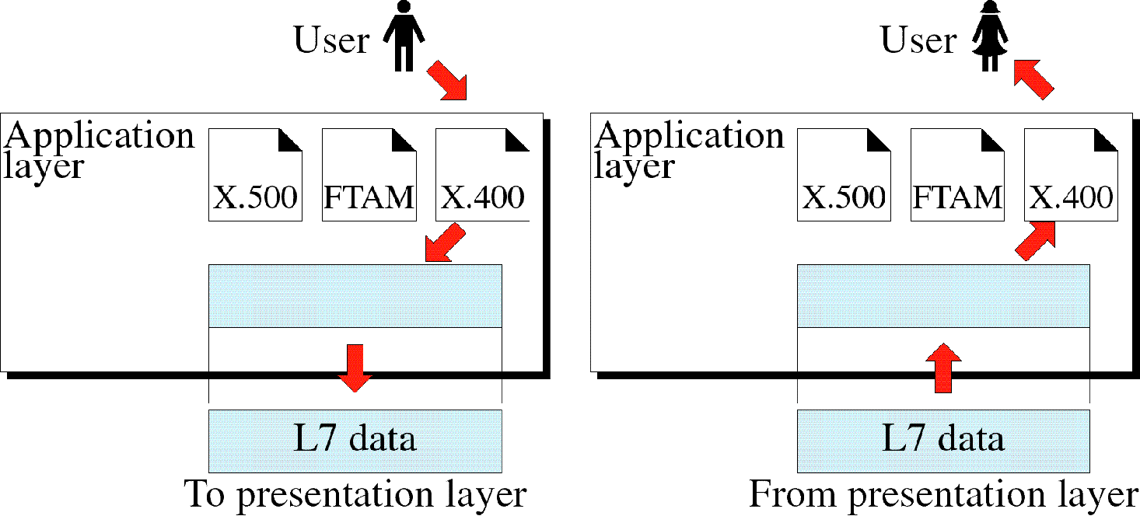
Application Layer

Slide 70
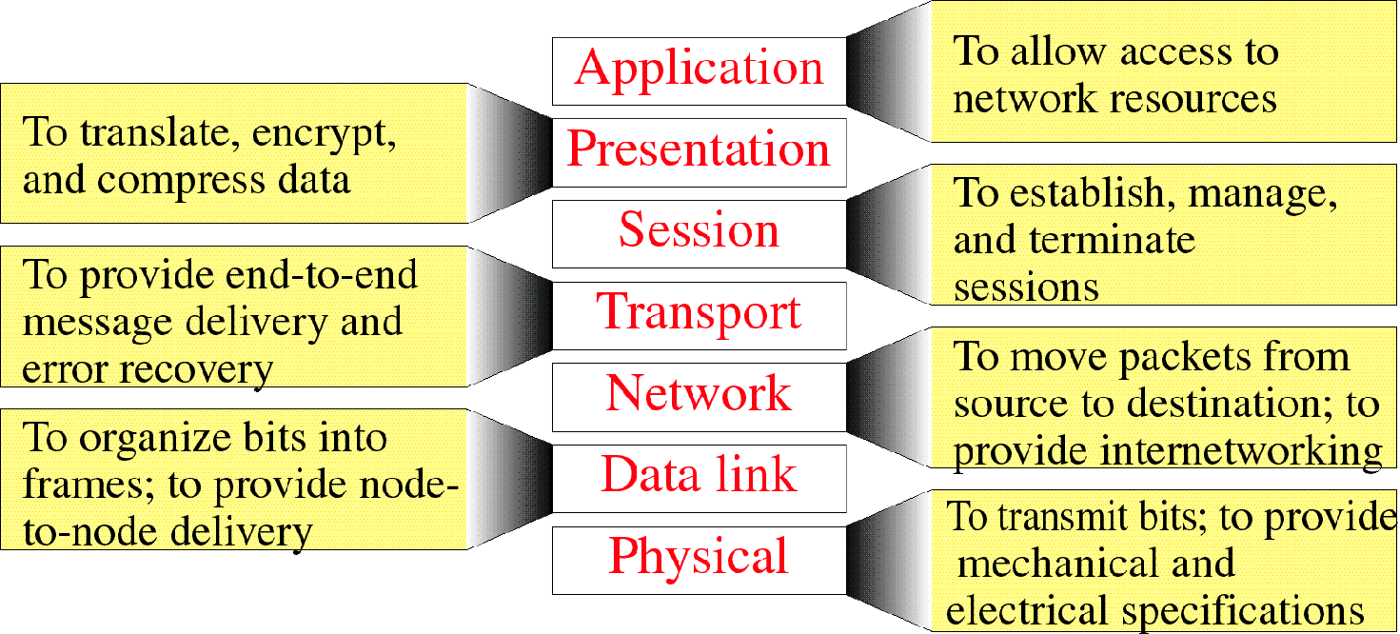
Summary of Layer Functions
© The McGraw-Hill Companies, Inc., 1998

Slide 71
TCP/IP PROTOCOL SUITE
TCP/IP protocol suite is made of five layers:
Application Layer
Transport Layer
Network Layer
Data Link Layer
Physical Layer
© The McGraw-Hill Companies, Inc., 1998

Slide 72
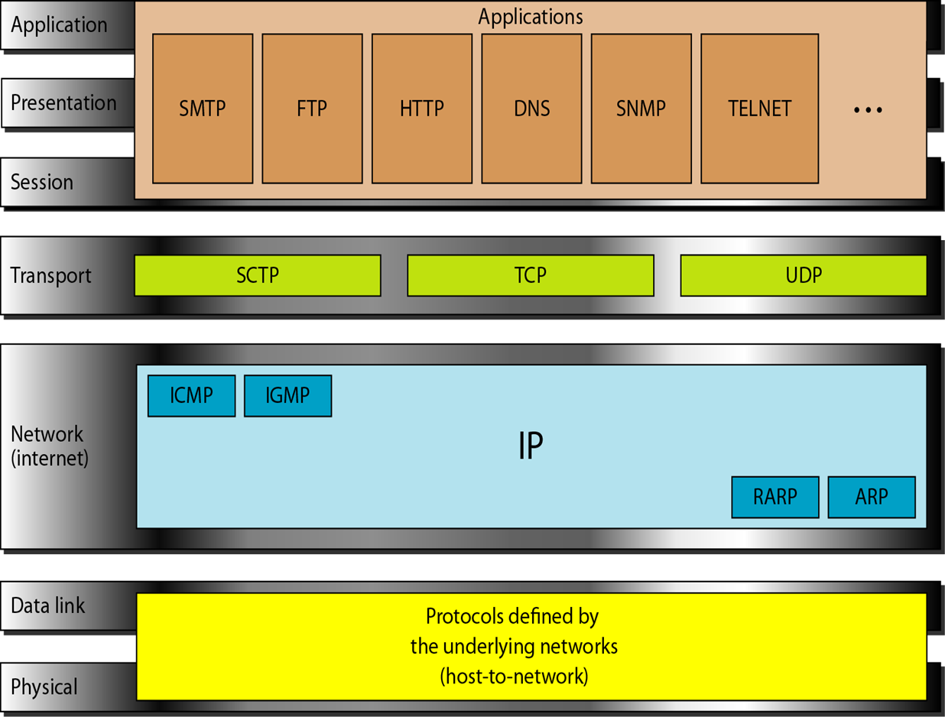
TCP/IP PROTOCOL SUITE
© The McGraw-Hill Companies, Inc., 1998

Slide 73
TCP/IP Model
Developed prior to OSI model
TCP/IP is a hierarchical protocol made up of interactive modules, each providing specific functionality, but they are not interdependent
© The McGraw-Hill Companies, Inc., 1998

Slide 74
Network Layer
TCP/IP does not support any specific protocol
All standard and proprietary protocols supported at this level.
© The McGraw-Hill Companies, Inc., 1998

Slide 75
Network Layer
At this level TCP/IP supports Internetworking protocol(IP).
IP in turn uses 4 supporting protocols.
ARP
RARP
ICMP
IGMP
© The McGraw-Hill Companies, Inc., 1998

Slide 76
Network Layer
Internetworking Protocol (IP)
IP is transmission mechanism used by TCP/IP
Unreliable and connection-less protocol- best effort delivery
No error checking or tracking.
Transports data in packets called datagrams.
Does not keep track of routes and no facility reordering.
© The McGraw-Hill Companies, Inc., 1998

Slide 77
Network Layer
Address Resolution Protocol (ARP)
Associates logical address with physical address.
ARP is used to find physical address of node when logical address is known.
Reverse Address Resolution Protocol (RARP)
RARP is used to find logical address of node when physical address is known.
Usually used when computer is connected to network for the first time.
© The McGraw-Hill Companies, Inc., 1998

Slide 78
Network Layer
Internet Control Message Protocol (ICMP)
Used by hosts and gateways to send notification of datagram problem to sender.
Internet Group Message Protocol (IGMP)
Used to facilitate simultaneous transmission of message to group of recipients.
© The McGraw-Hill Companies, Inc., 1998

Slide 79
Transport Layer
IP is host to host protocol
Transport layer has three protocols:
UDP (User Datagram Protocol)
TCP (Transmission Control Protocol)
SCTP (Stream Control Transmission Protocol)
© The McGraw-Hill Companies, Inc., 1998

Slide 80
Transport Layer
User Datagram Protocol (UDP):
Process to Process
Adds only port address , error control , checksum etc. to data from upper layers.
© The McGraw-Hill Companies, Inc., 1998

Slide 81
Transport Layer
Transmission Control Protocol (TCP)
Reliable stream protocol.
Data is divided into segments.
Segment contain sequence number for reordering.
At receiving end , TCP collects each datagram and reorders it based on sequence numbers
Stream Control Transmission Protocol (SCTP)
Combines features of TCP and UDP
© The McGraw-Hill Companies, Inc., 1998

Slide 82
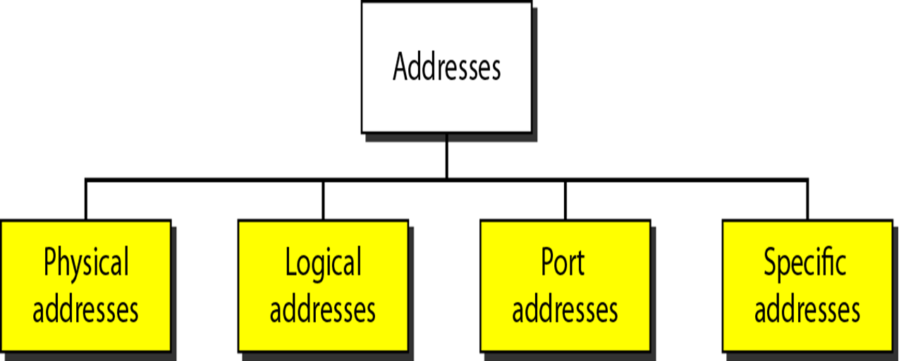
Addressing
© The McGraw-Hill Companies, Inc., 1998

Slide 83
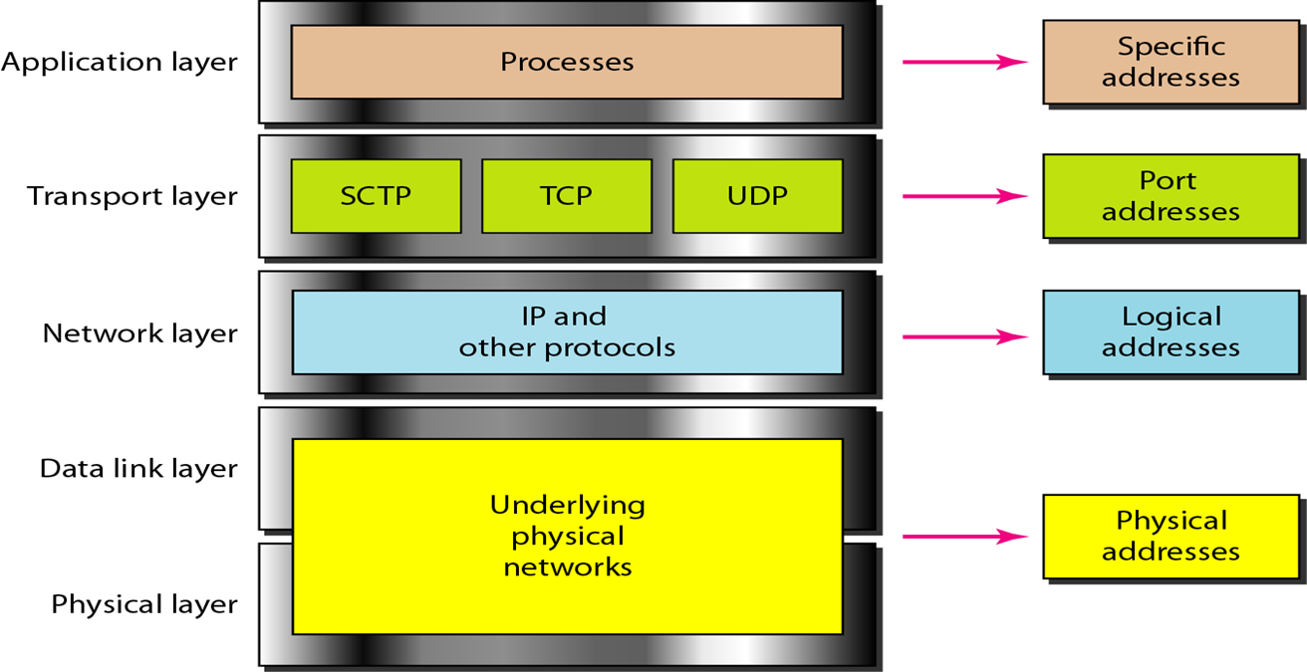
Relationship of layers and addresses in TCP/IP
© The McGraw-Hill Companies, Inc., 1998

Slide 84
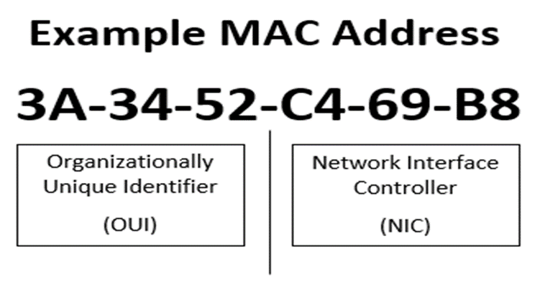
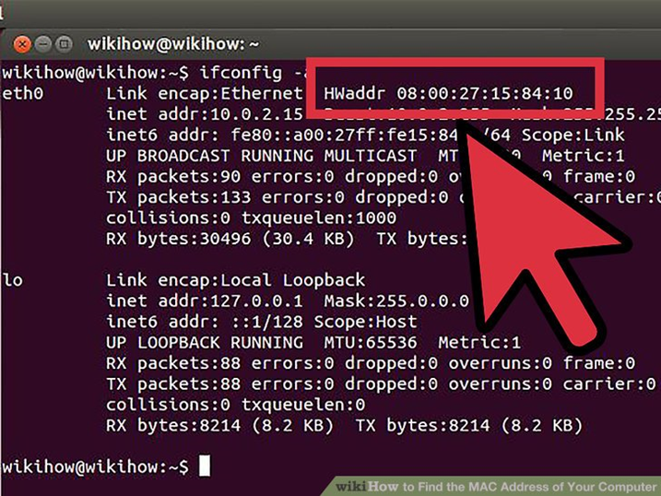
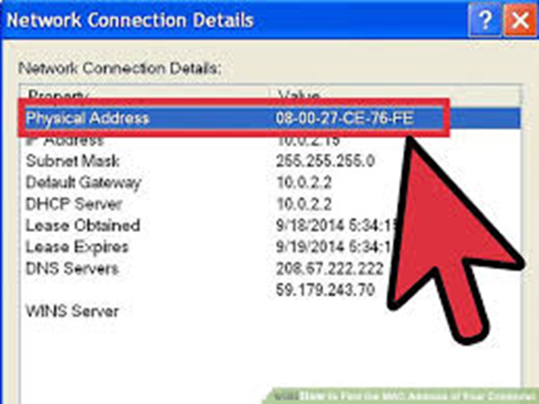
MAC Address

Slide 85
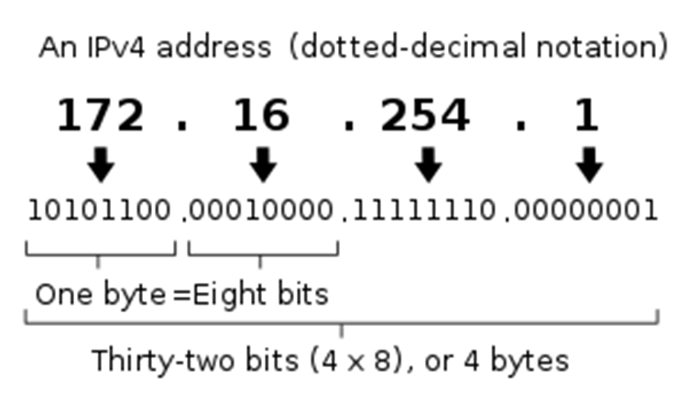
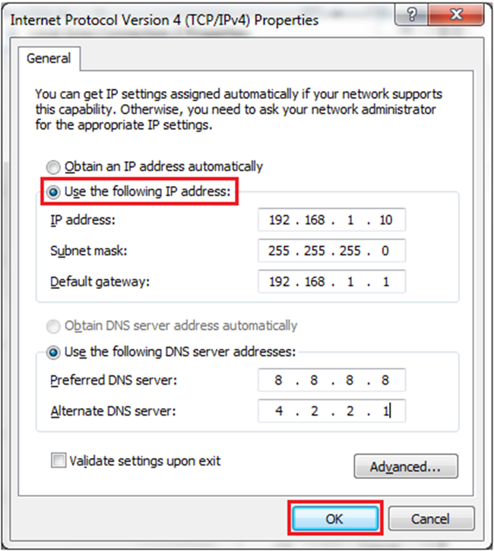
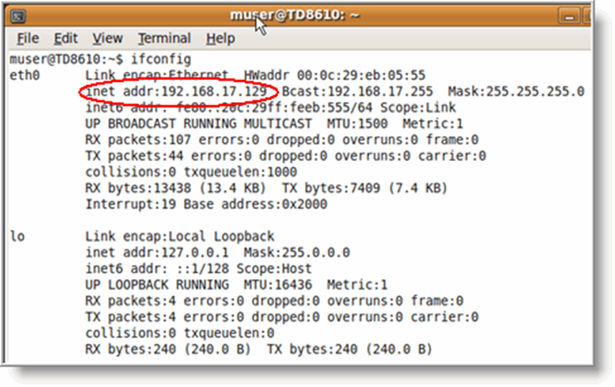
IP Address

Slide 86
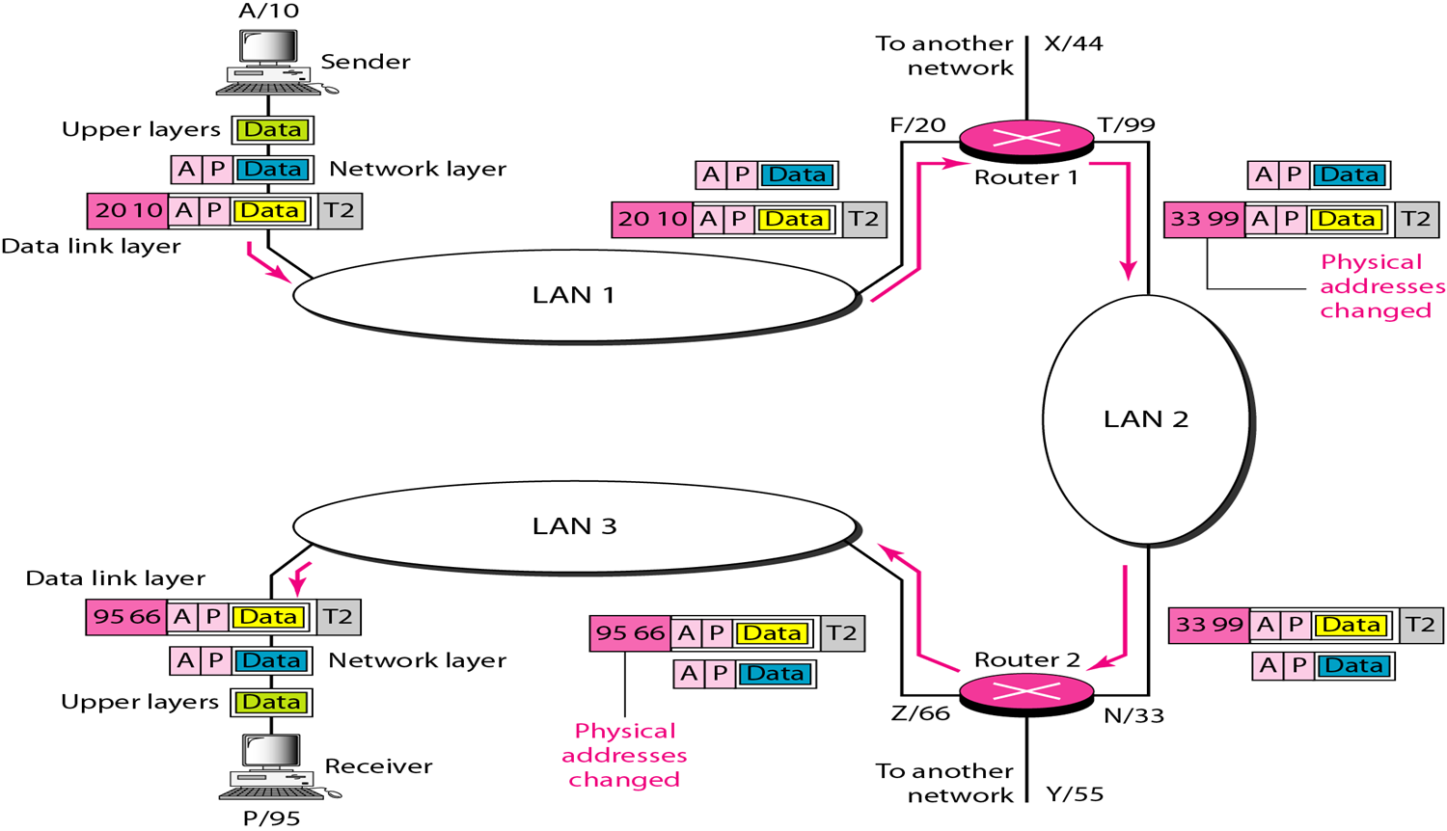
IP Address

Slide 87
References
“Data Communication and Networking”, Behrouz Forouzan 5e
“TCP/IP Protocol Suite “, Behrouz Forouzan 4e.
“Computer Networks “, A.S.Tanenbaum 5e.

